Slide 1
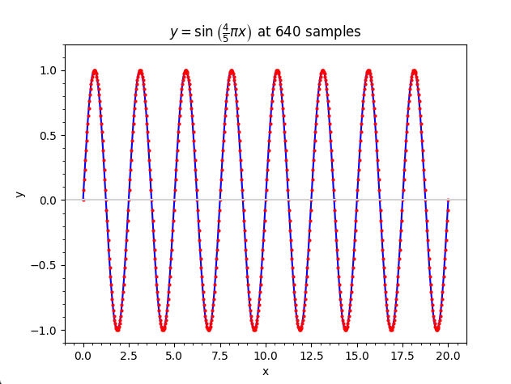
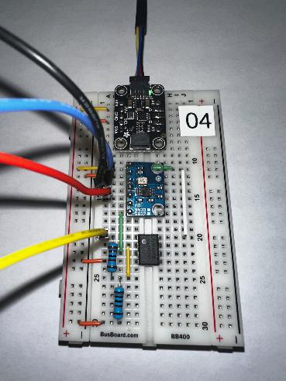
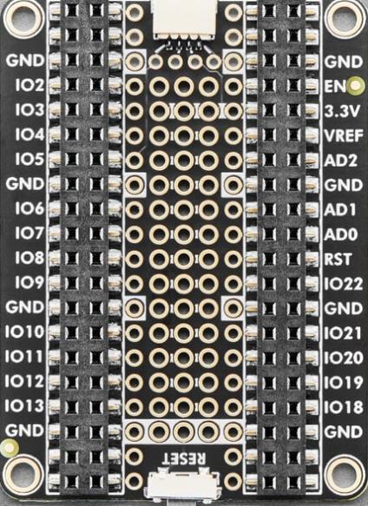
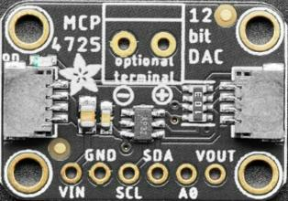
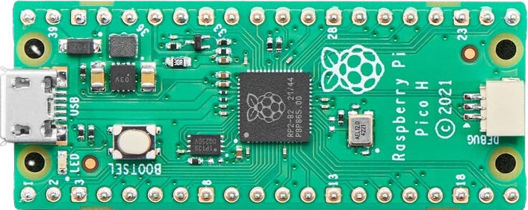
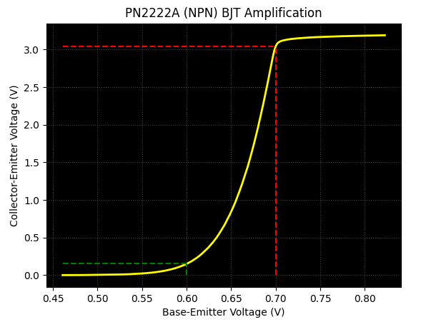

Control System Electronics 201
Using Python on a Microcontroller with Sensors
Board 03
Diodes, Ohm's Law
Dave Biersach
dbiersach@bnl.gov

Slide 2
Board 03 – Goals
Learn about diodes, including bias, forward voltage, non-ohmic region, and current limiting resistors
Calculate the band gap for electrons in a Blue LED to determine the voltage necessary for it to emit photons
Differentiate the role of voltage and current in Einstein’s Photon Energy Equation and the brightness of an LED
Apply an NPN BJT in a Common Collector (Emitter Follower) configuration to create a current Buffer that offers high impedance separation between circuit stages
Use Ohm’s Law and Gauss’s Method of Least Squares to identify unknown resistances

Slide 3
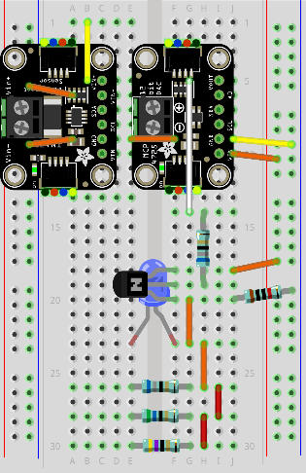
Review Board 03
Board 03 will introduce you to using a current sensor to measure a diode I-V curve, a Blue LED, and using Ohm’s Law to determine the resistance of an unknown resistor
Current
Sensor
DAC
BJT
In a Common Collector configuration
Blue
LED
Three Unknown Resistors

Slide 4
About Diodes
Diodes are semiconductor components that can block a reversed current flow. As such, they are like a one-way valve and are often used to rectify (clip unwanted voltages in) AC (alternating current) signals
Diodes also act as a kind of switch – current cannot flow through a diode until the voltage exceeds a minimum threshold
When the forward voltage exceeds the diode's internal P-N junction barrier voltage (about +0.7V) a charge carrier avalanche occurs
Once sufficiently biased, the diode's forward current increases rapidly for a minimal rise in source voltage, producing a non-linear curve with a distinct "knee" point

Slide 5
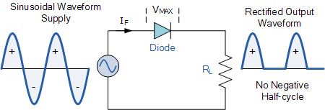
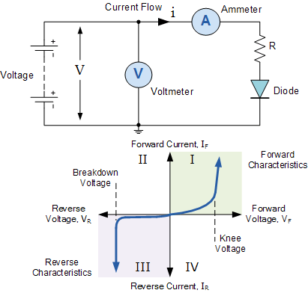
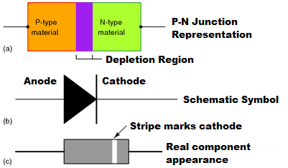
About Diodes
Diode as an AC Rectifier
Diode as a Current Switch

Slide 6
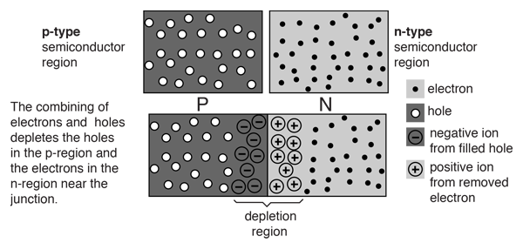
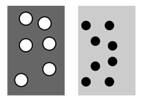
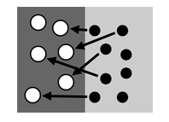
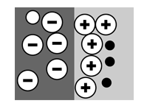
About Diodes
"Holes"
Electrons
Initial Contact
Equilibrium (0V)
No current can flow

Slide 7
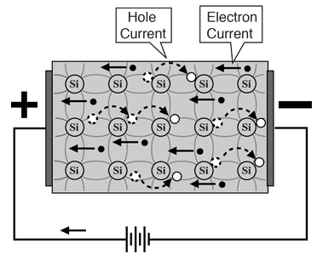
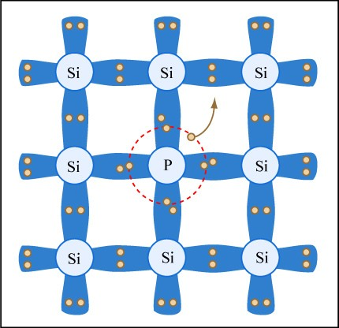
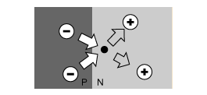
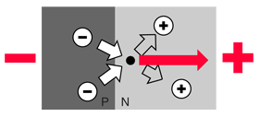
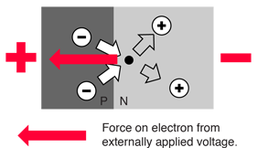
About Diodes
Phosphorus donates electrons
Equilibrium
Reverse Biased
Forward Biased
For current to pass through diode, more
electrons must flow into the P region!

Slide 8
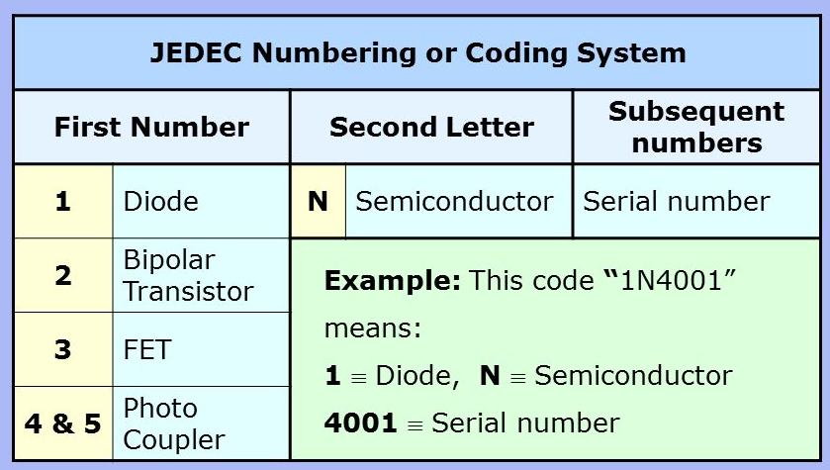
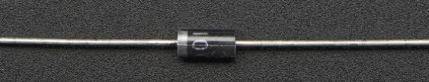
About Diodes
1N4001 Diode

Slide 9
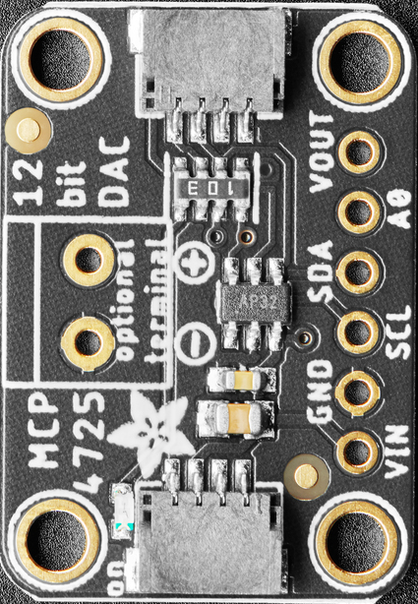

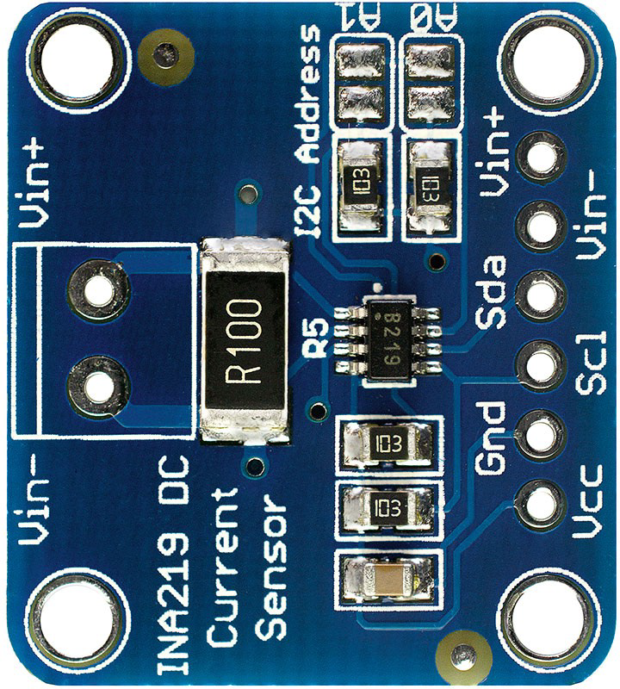
Lab Design
To MCU I²C Bus
All devices on the I2C bus have their respective SDA and SCL pins connected
All Vin and GND pins are connected to the power rails
The Vout pin of MCP4725 DAC ranges voltage (0V to +1.2V) as input to the diode anode
The INA219 Current sensor will measure the current flowing out of the Diode’s cathode
Inside the INA219, the Vin+ pin (connected to the diode) and Vin- pin (connected to GND) are bridged by a 0.1 Ω shunt resistor (R100), thus closing the circuit’s current path
1N4001
Diode
Anode (+)
Cathode (-)

Slide 10
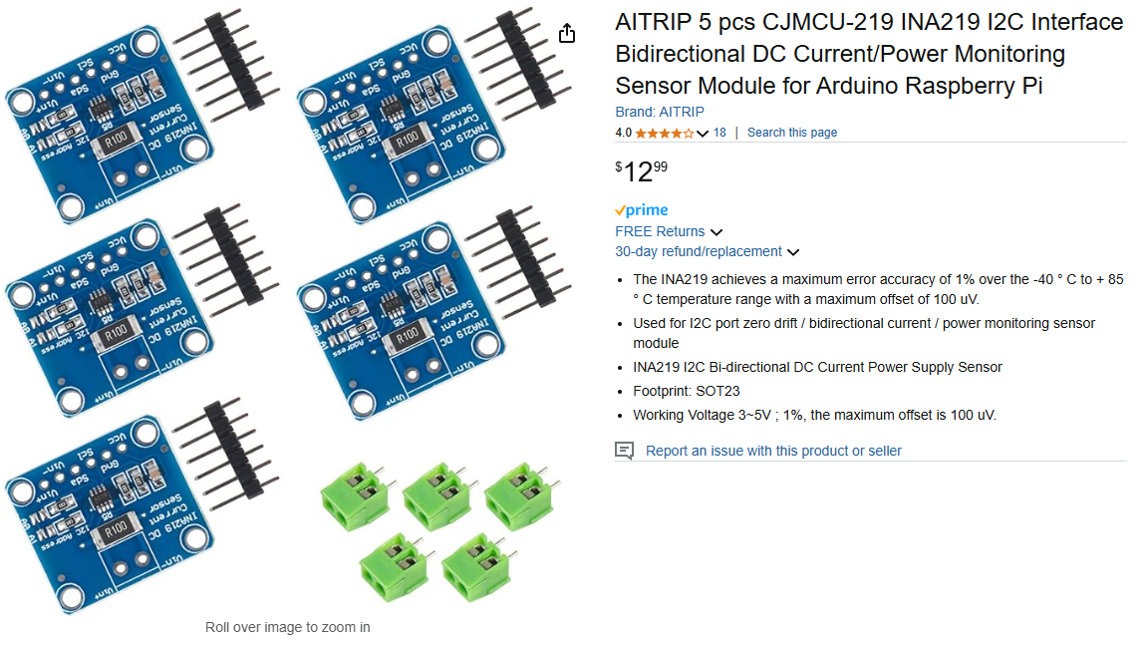
AITRIP INA219 – Current Sensor with I²C
https://www.amazon.com/product-reviews/B08R9MGSWV

Slide 11
Unplug the MCU before changing any wiring!
As we move between each “experiment” on a given breadboard or switch to an entirely new Board #, it is crucial that you FIRST UNPLUG the USB cord!
I recommend unplugging the cord at the PC end – leave the cord connected to the Micro USB port on the Pico
It is dangerous to change any wiring while the MCU is still drawing power from your laptop’s USB port. (NOTE: We will do this only during this Ohm’s Law lab on Board #3!)
If you incorrectly connect a jumper wire between the Pico and the breadboard while the Pico is drawing power from your PC, you can permanently damage your PC’s USB port
Have your partner double-check your wiring every step!

Slide 12
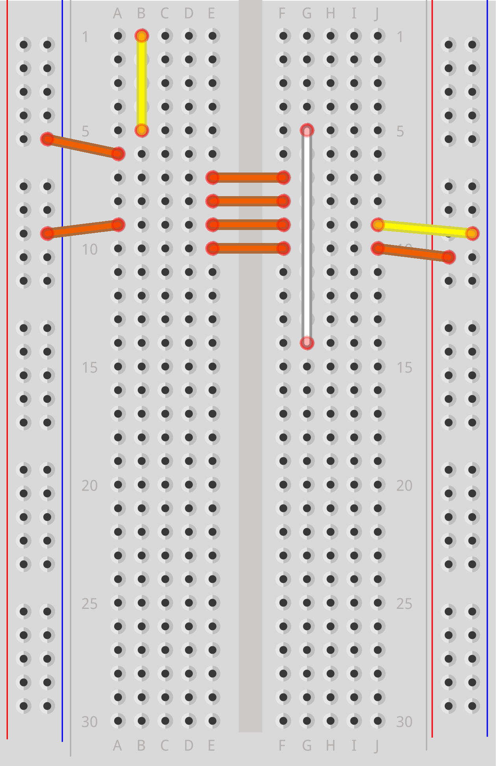
Power Flow (Vcc = +3.3V)

Slide 13
Power Flow (GND)

Slide 14
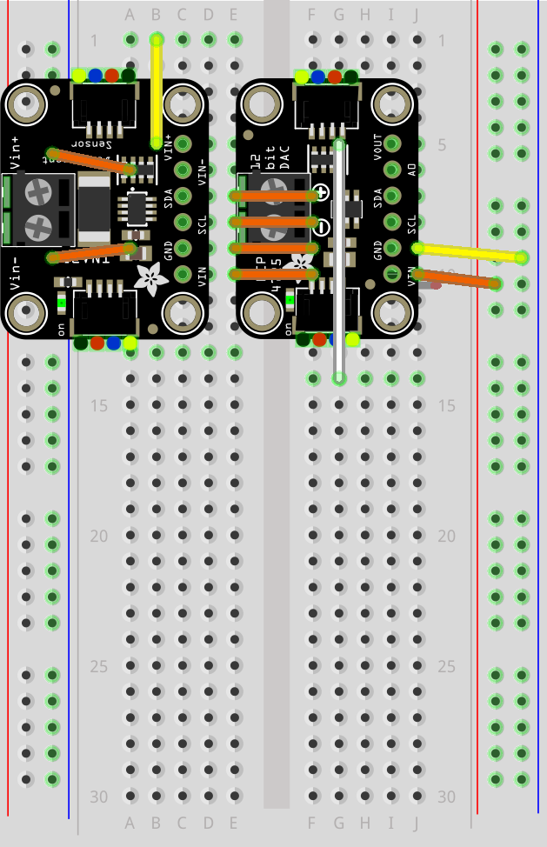
I²C Bus (SCL + SDA)
Insert the Vin pin on the DAC into row 10 on the breadboard
Carefully remove the DAC from Board 02 and insert it into Board 03 precisely as shown
The Current Sensor and DAC should be aligned at their bottom edge

Slide 15
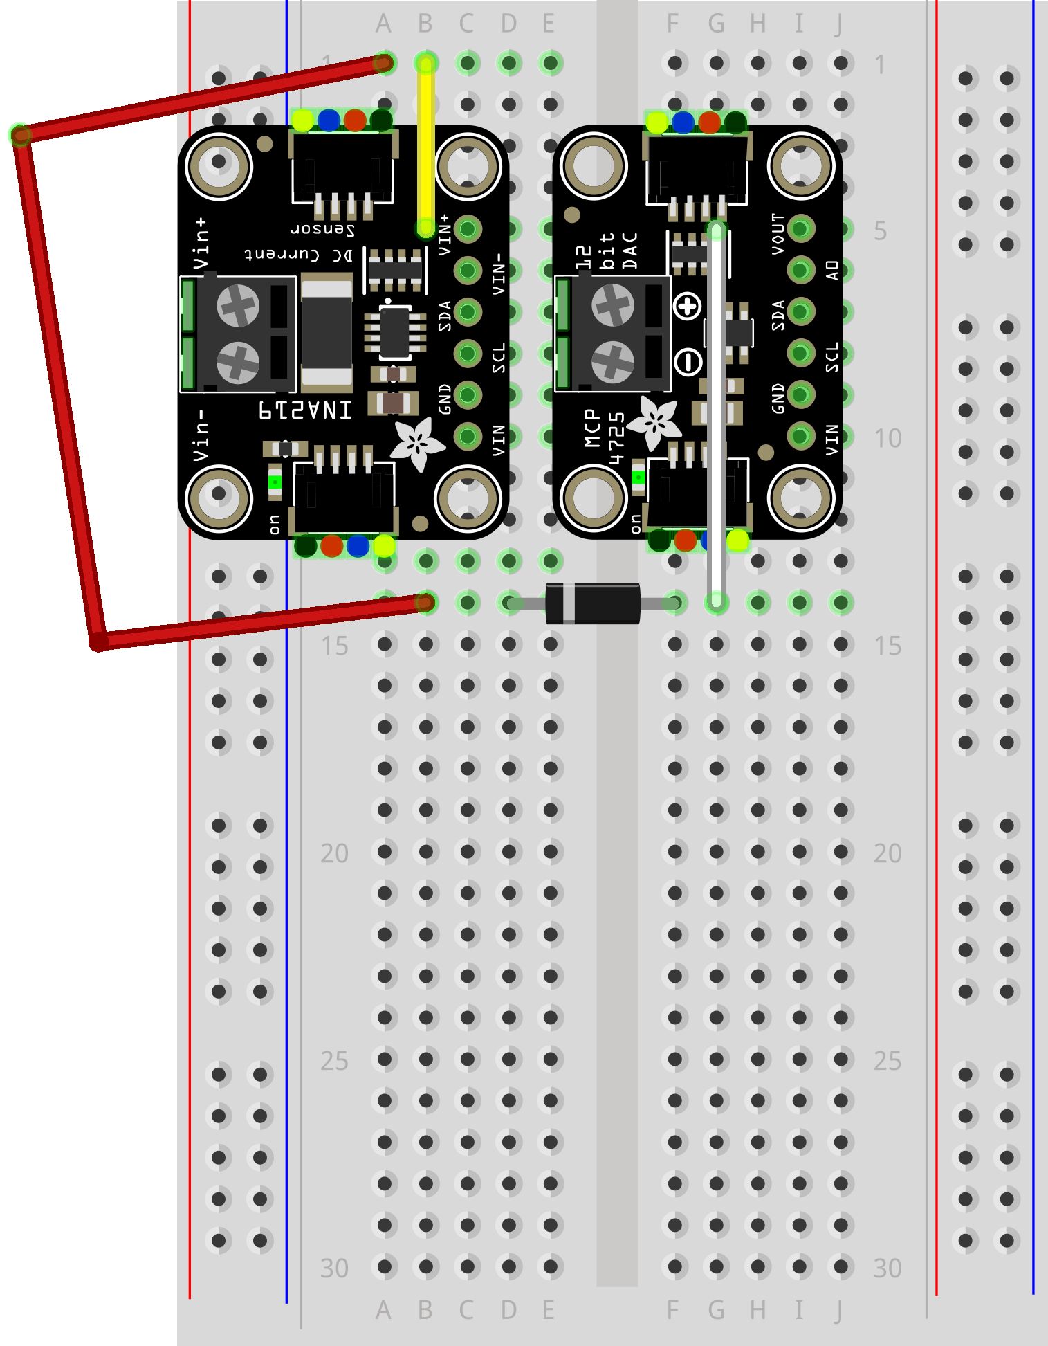
Wire Your Pico to Board 03
RED Jumper Wire

Slide 16
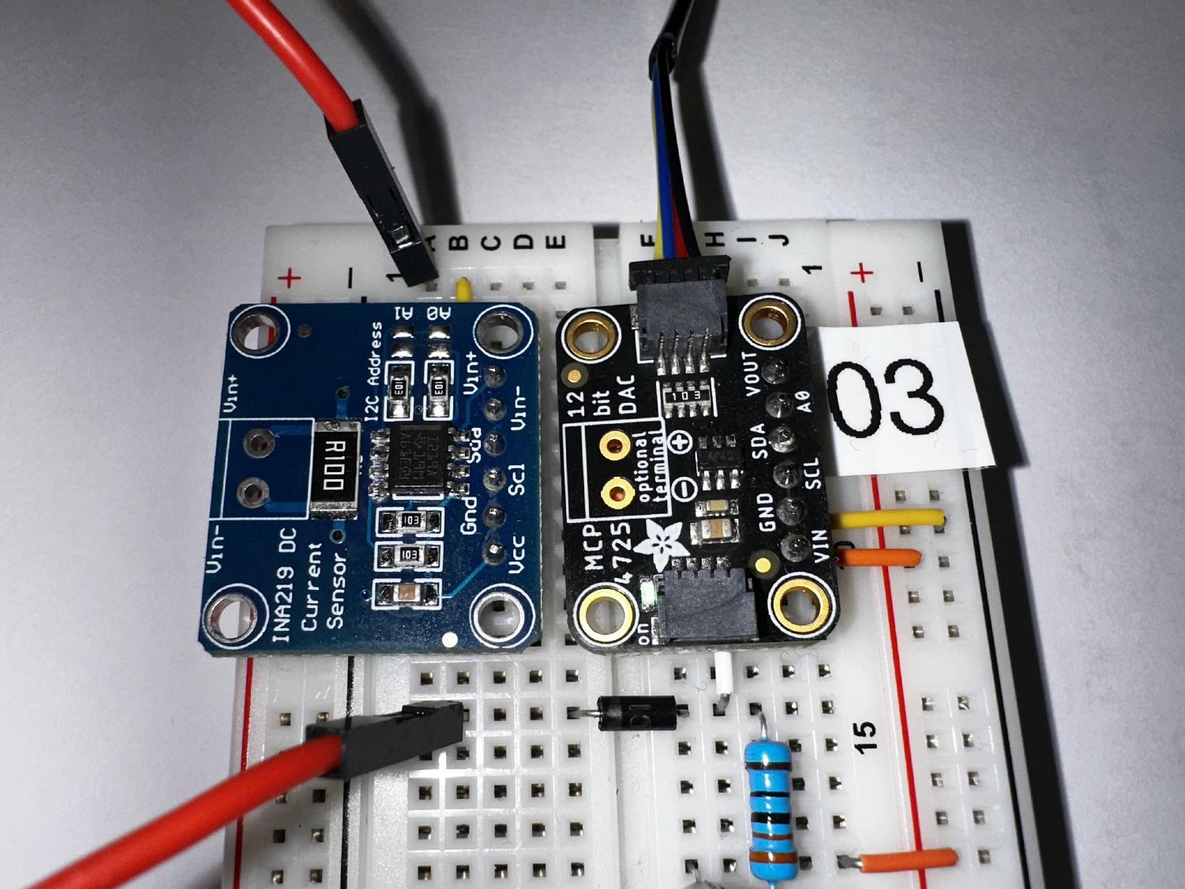
Wire Your Pico to Board 03
Qwiic Cable goes into the DAC

Slide 17
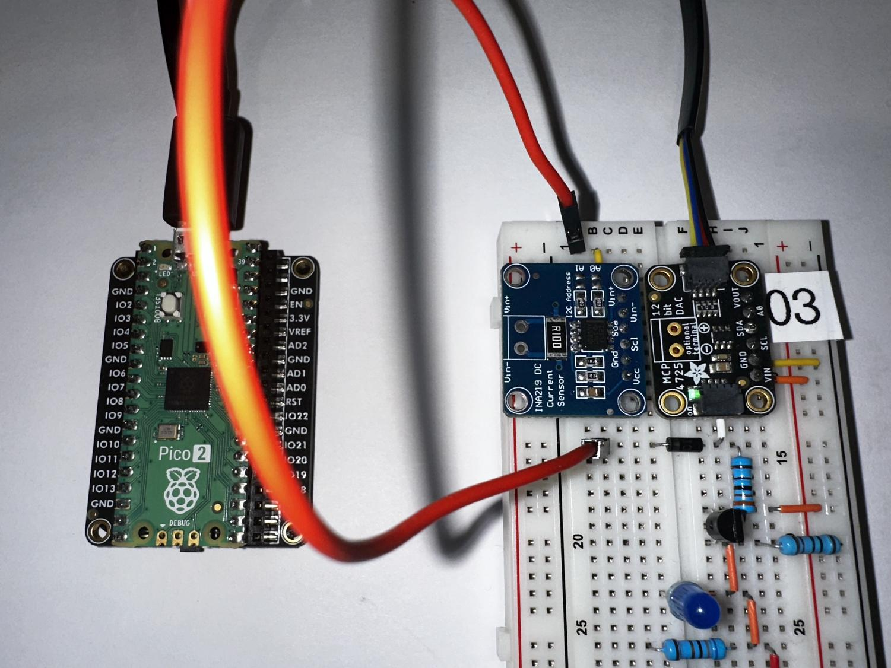
Wire Your Pico to Board 03

Slide 18
Big Picture of diode_ivcurve Lab
code.py running on Pi Pico
read_samples.py running on PC
Waits for a serial (USB) port connection from the PC
Connects to the MCU over the serial (USB) port
Waits for the command "r" to be sent by the PC over the USB (CDC Data) port
Sends the string "r" to the MCU over the CDC Data port
Waits to receive the sample data from the MCU and then saves the values to samples.csv data file
Via I²C, the MCU has the DAC raise the volts from 0V to 1.2V over 200 steps, measuring the average current at each step
plot_samples.py running on PC
Sends the volts and amps to the PC over the USB port
Reads the samples.csv file and plots the voltage vs. current graph for the diode (I-V Curve)

Slide 19
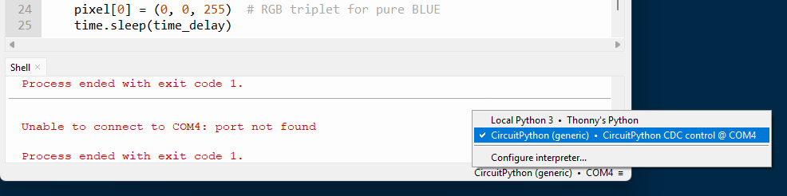
Plug the USB Cord into your PC
After you plug the USB Cord (still connected to the Pico) back into your PC, you must once again tell Thonny to reconnect back to CircuitPython on the MCU
Thonny must display “CircuitPython CDC control…” as the current Interpreter selection in the bottom right of the main application window (your COM# port may be different)

Slide 20
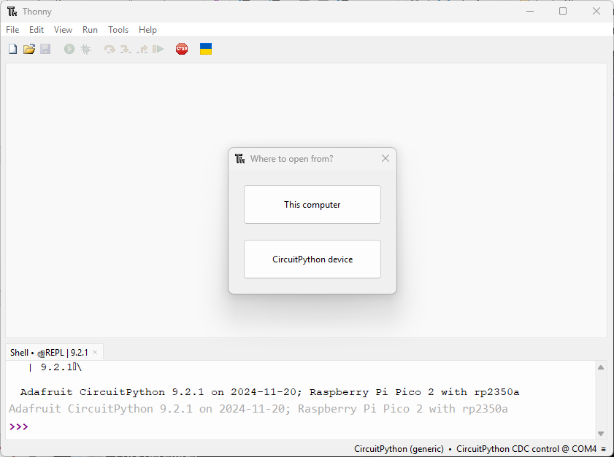
Open code.py in folder diode_ivcurve

Slide 21
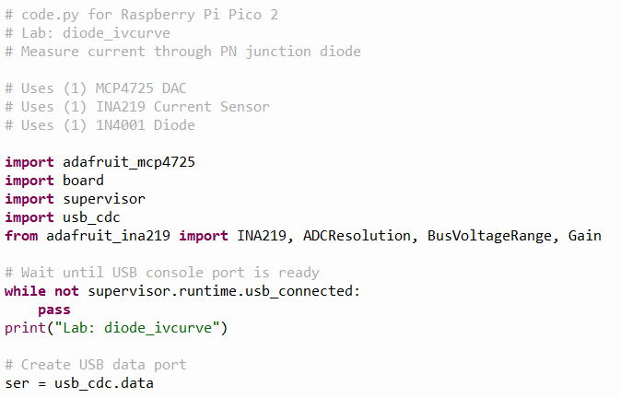
View code.py
①
②
③
④

Slide 22
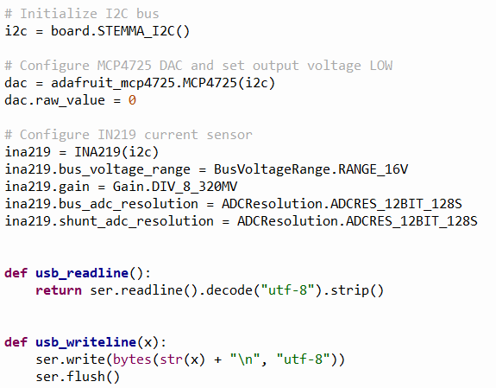
View code.py
①
②
③
④
⑤
⑥

Slide 23
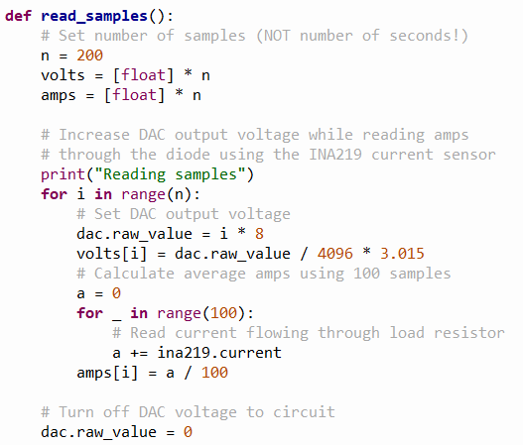
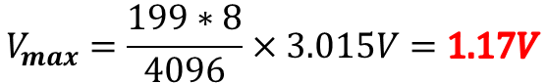
View code.py
①
②
Python ranges are [0,n)
The 330Ω resistor connected after the DAC reduces the available DAC voltage from 3.3V to 3.015V
③
④
⑤
⑥
⑦
⑧
⑨
⑩
$$V_{max}=\frac{199∗8}{4096}×3.015V=1.17V$$

Slide 24
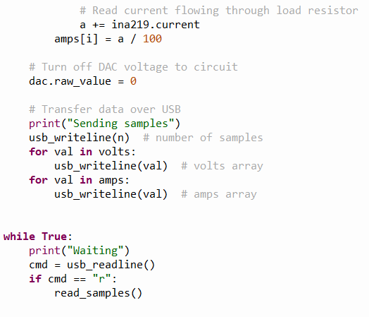
View code.py
①
②
③
④
⑤

Slide 25
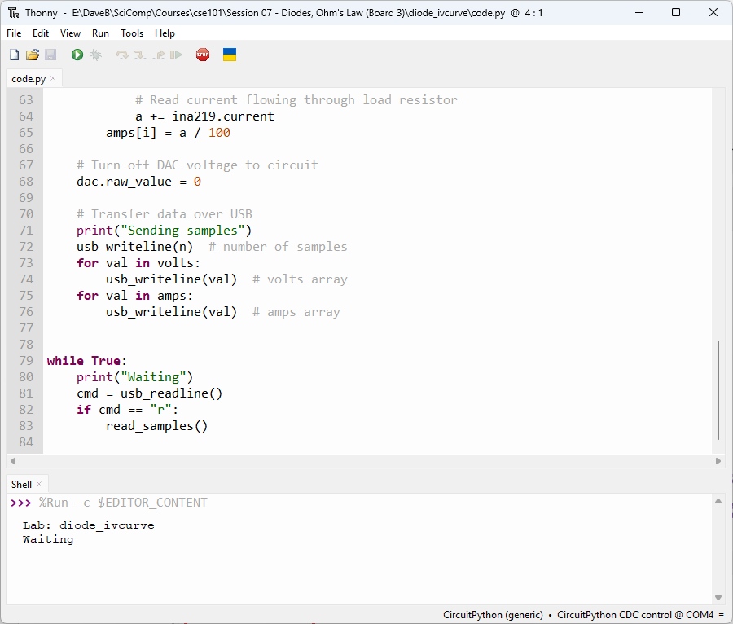
Run code.py
The Pi Pico is now just waiting…

Slide 26
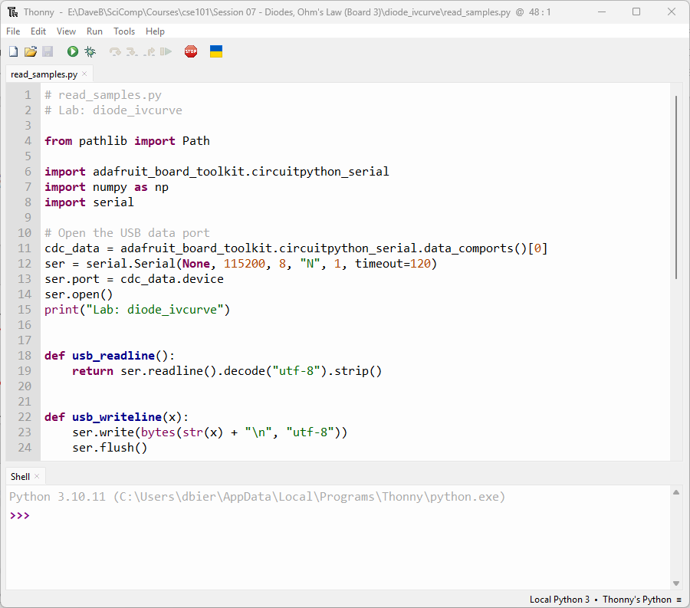
In 2nd Thonny - Open read_samples.py
①
②
③

Slide 27
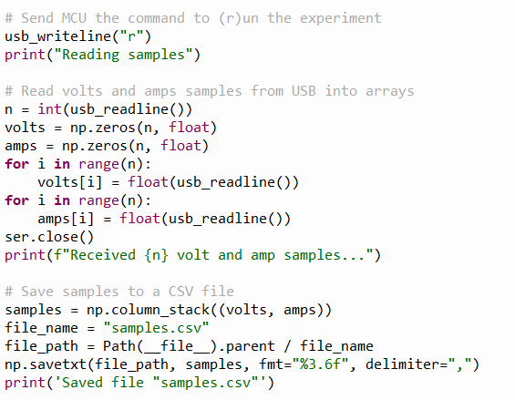
View read_samples.py
①
②
③
④
⑤
⑥
⑦
⑧

Slide 28
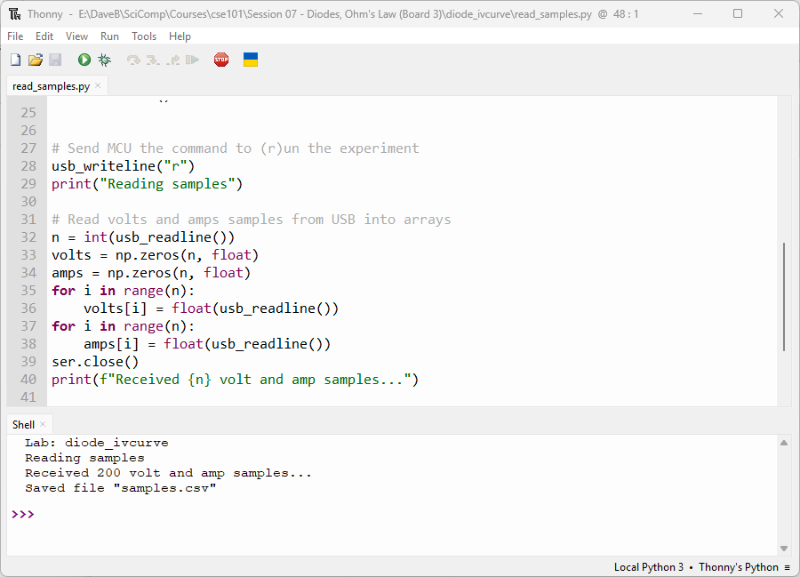
Run read_samples.py
①

Slide 29
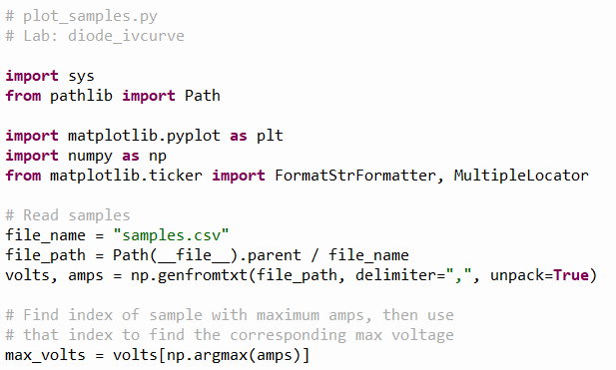
In 2nd Thonny - Open plot_samples.py
①
②
③

Slide 30
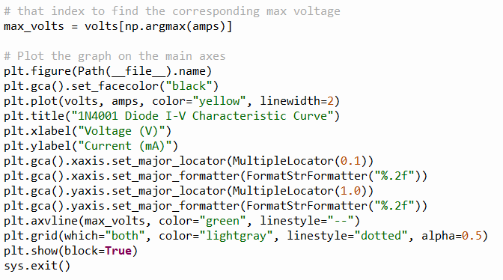
View plot_samples.py
①
②
③
④

Slide 31
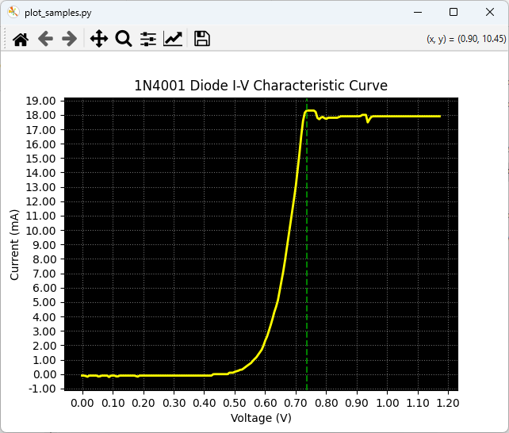
Run plot_samples.py

Slide 32
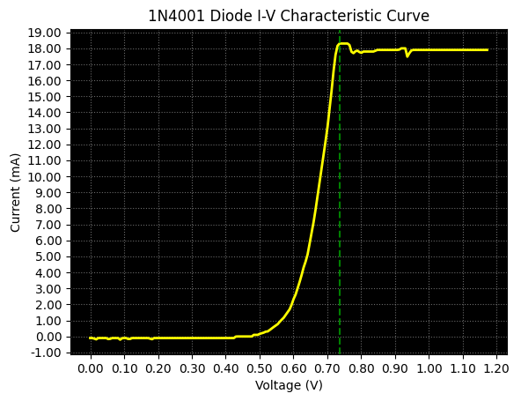
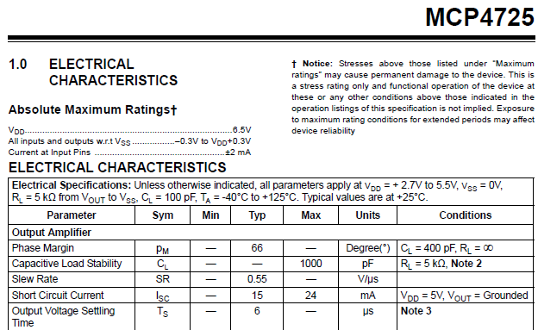
Check plot_samples.py
Constant Slope
“Ohmic” Region
The MCP4725 can typically only source about 18 mA
"Knee" or cut-in voltage region

Slide 33
Check plot_samples.py
Why does this signal jitter?
Constant Slope
“Ohmic” Region
"Knee" or cut-in voltage region

Slide 34
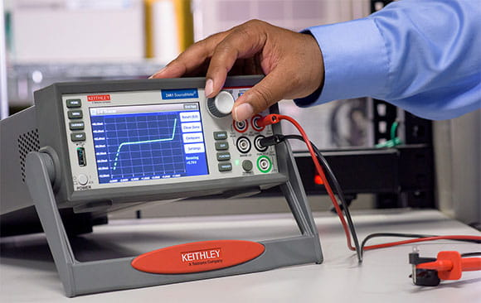
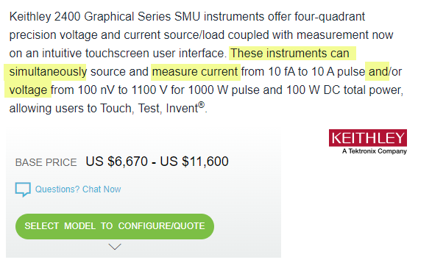
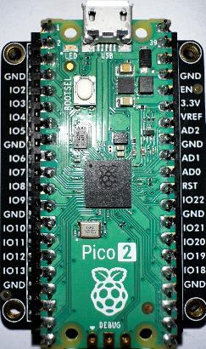
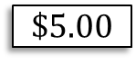
The Value of Knowing How to Code
$$\$5.00$$

Slide 35
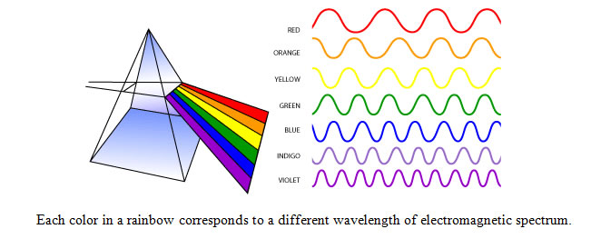
The Visible Light Spectrum

Slide 36

The Complete “Light” Spectrum

Slide 37

The Visible Light Spectrum

Slide 38


Light Spectrum
But how is light produced from energy?

Slide 39

Electron Transitions Emit Photons
←Increasing Energy
The higher the initial orbit of the electron, the more energy it radiates when it transitions to a lower orbit

Slide 40
Band Gap Energy for a Red LED
LEDs that glow Red typically emit light with a wavelength between 620-750 nanometers (nm)
We can calculate the Band Gap Energy for a Red LED using Einstein’s Equation from his 1905 paper
$$E=\frac{hc}{λ}$$
$E=$ Energy in electron volts $(eV)$
$h=$ Planck’s constant $(4.1357 ×{10}^{−15} eV⋅s)$
$c=$ Speed of Light in a vacuum $(3 ×{10}^{8} m/s)$
$λ=$ Wavelength in meters $(m)$

Slide 41
Band Gap Energy for a Red LED
LEDs that glow Red typically emit light with a wavelength between 620-750 nanometers (nm)
Therefore, to make a Red LED have an easily visible glow, we need to provide 1.91 V
$$E=\frac{hc}{λ}=\frac{\left(4.1357×{10}^{−15}\right)\left(3 ×{10}^{8}\right)}{650×{10}^{−9}}=1.91 V$$

Slide 42
Lab Design
We want to drive a Blue LED by having the MCP4725 DAC provide sufficient voltage to the LED anode such that the LED will turn on and shine brightly
A typical small 5mm Blue LED requires a minimum current of 20mA to emit enough photons to be visibly lit
Unfortunately, as we saw in the prior lab, our DAC can only source a maximum of about 18mA
Fortunately, we can configure a PN2222A NPN transistor as a Common Collector amplifier to help boost the LED current up to the maximum the I²C Bus can provide (via the Qwiic connector from the MCU), which is about 50mA

Slide 43
Lab Design
A Common Collector amplifier is often called an Emitter Follower (or Buffer) as it offers only unity gain (1x) in voltage but can provide significant current gain
A CC amplifier has high input impedance which minimizes loading effects on the preceding stage (i.e., the DAC)
In a CC configuration, we take the output from the Emitter pin (as opposed to the Collector pin in a Common Emitter amplifier as we used in Session 05)
Unlike a CE amplifier in which the output phase is inverted compared to the input, with a CC amplifier, the output is in phase with the input

Slide 44
Unplug the MCU before changing any wiring!
As we move between each “experiment” on a given breadboard or switch to an entirely new Board #, it is crucial that you FIRST UNPLUG the USB cord!
I recommend unplugging the cord at the PC end – leave the cord connected to the Micro USB port on the Pico
It is dangerous to change any wiring while the MCU is still drawing power from your laptop’s USB port. (NOTE: We will do this only during this Ohm’s Law lab on Board #3!)
If you incorrectly connect a jumper wire between the Pico and the breadboard while the Pico is drawing power from your PC, you can permanently damage your PC’s USB port
Have your partner double-check your wiring every step!

Slide 45

Wire Your Pico to Board 03
A 330 Ω resistor limits the current flowing into the Base of the BJT
In the Common Collector configuration, we take the BJT output from the Emitter pin
In a buffer,
the Collector pin
is tied to V_{CC}
In a buffer,
the Emitter pin is tied to GND through a resistor
(here a 10K Ω)
BLACK Jumper Wire

Slide 46

Wire Your Pico to Board 03
The goal is to shine the Blue LED brightly

Slide 47
Plug the USB Cord into your PC
After you plug the USB Cord (still connected to the Pico) back into your PC, you must once again tell Thonny to reconnect back to CircuitPython on the MCU
Thonny must display “CircuitPython CDC control…” as the current Interpreter selection in the bottom right of the main application window (your COM# port may be different)

Slide 48
Open code.py in folder band_gap

Slide 49

View code.py
①
②
③
④

Slide 50
Run code.py
What happened to the Blue LED?

Slide 51





Band Gap Energy for a Blue LED
LEDs that glow Blue typically emit light with a wavelength between 450-495 nanometers (nm)
What voltage must we supply to light up a Blue LED?
$$E=\frac{hc}{λ}$$
$E=$ Energy in electron volts $(eV)$
$h=$ Planck’s constant $(4.1357 ×{10}^{−15} eV⋅s)$
$c=$ Speed of Light in a vacuum $(3 ×{10}^{8} m/s)$
$λ=$ Wavelength in meters $(m)$

Slide 52

Band Gap Energy for a Blue LED
LEDs that glow Blue typically emit light with a wavelength between 450-495 nanometers (nm)
Therefore, to make a Blue LED have an easily visible glow, we need to provide 2.64 V
$$E=\frac{hc}{λ}=\frac{\left(4.1357×{10}^{−15}\right)\left(3 ×{10}^{8}\right)}{470×{10}^{−9}}=2.64 V$$

Slide 53

Edit code.py
①

Slide 54

Run code.py
Albert Einstein 1905
(26 years old)
What happened to the Blue LED?
①

Slide 55






Voltage, Current, Resistance
Potential Energy
Amount
of Flow
V = Voltage
Volts (V)
I = Current
Amps (A)
R = Resistance
Ohms ($Ω$)
Alessandro Volta
(1745 – 1827)
André Ampère
(1775 – 1836)
Georg Ohm
(1789 – 1854)

Slide 56




Voltage, Current, Resistance
Current
Ohm's Law
Volts
Resistance
$$V=IR$$
A Circuit
Schematic
James Watt
(1736 – 1819)
Joules (Energy) per second

Slide 57

Walking in Ohm's Footsteps
Ohm's Law is a mathematical relationship between voltage, current, and resistance
$$v=iR→i=\frac{v}{R}→R=\frac{v}{i}$$
Ohm did not imply that if you divide the voltage output of a circuit by an infinitely small resistance, then that circuit will be able to produce an infinite amount of current
Most circuits are current limited – even batteries can only provide a certain maximum number of amp-hours
Resistance can vary by the temperature of the resistor
Resistance can be considered a ratio of voltage to current – think of $v/i$ as the slope of a line
Electrical engineers use $j$ for $\sqrt{−1}$

Slide 58




Method of Least Squares
Carl Friedrich Gauss
(1777-1855)

Slide 59
Walking in Ohm's Footsteps
We want to sample (measure) the current flowing through an unknown resistor as we slowly increase voltage
Using linear regression (method of least squares), we can calculate the line of best fit which passes through the observed data values (volts vs. current)
The slope of that line is the ratio $v/i$ which will tell us the resistance in Ohms of the unknown resistor under test

Slide 60
Unplug the MCU before changing any wiring!
As we move between each “experiment” on a given breadboard or switch to an entirely new Board #, it is crucial that you FIRST UNPLUG the USB cord!
I recommend unplugging the cord at the PC end – leave the cord connected to the Micro USB port on the Pico
It is dangerous to change any wiring while the MCU is still drawing power from your laptop’s USB port. (NOTE: We will do this only during this Ohm’s Law lab on Board #3!)
If you incorrectly connect a jumper wire between the Pico and the breadboard while the Pico is drawing power from your PC, you can permanently damage your PC’s USB port
Have your partner double-check your wiring every step!

Slide 61

Wire Your Pico to Board 03
RED Jumper Wire
This Common Collector amplifier (Buffer) will provide enough current so that even after passing through the unknown resistor, the INA219 will get a reasonably accurate measurement
The Emitter pin output will be 0.66V lower than the DAC output pin but it can source a much higher current
Unknown Resistor 1

Slide 62

Wire Your Pico to Board 03

Slide 63

Wire Your Pico to Board 03
The red jumper goes to 1st resistor

Slide 64

Wire Your Pico to Board 03
This yellow wire routes to the input pin (Vin+) of the Current Sensor

Slide 65
Big Picture of ohms_law Lab
code.py running on Pi Pico
read_samples.py running on PC
Waits for a serial (USB) port connection from the PC
Connects to the MCU over the serial (USB) port, asks user to enter what resistor # is in use
Waits for the command "r" to be sent by the PC over the USB (CDC Data) port
Sends the string "r" to the MCU over the CDC Data port
Waits to receive the sample data from the MCU and then saves the values to resistor#.csv data file
Via I²C, the MCU has the DAC raise volts (0.67V → 2.42V) over 100 steps, measuring the average current at each step
plot_samples.py running on PC
Sends the volts and amps to the PC over the USB port
Reads all resistor#.csv files and plots the V/I line for each resistor, estimating the slope for each line

Slide 66
Plug the USB Cord into your PC
After you plug the USB Cord (still connected to the Pico) back into your PC, you must once again tell Thonny to reconnect back to CircuitPython on the MCU
Thonny must display “CircuitPython CDC control…” as the current Interpreter selection in the bottom right of the main application window (your COM# port may be different)

Slide 67
Open code.py in folder ohms_law

Slide 68

View code.py
①
②
③
④

Slide 69

View code.py
①
②
③
④

Slide 70



View code.py
①
When the CC BJT is fully saturated, the max available voltage from the DAC is only 2.42V
②
③
④
⑤
⑥
⑦
$$V_{min}=\frac{1125}{4095}×2.42=0.67V$$
$$V_{max}=\frac{1125+99∗30}{4096}×2.42=2.42V$$

Slide 71

Run code.py
The Pi Pico is now just waiting…

Slide 72

In 2nd Thonny - Open read_samples.py
①
②
③

Slide 73

View read_samples.py
①
②
③
④
⑤
⑥
⑦
⑧
⑨
⑩

Slide 74
View read_samples.py
①
②
③

Slide 75

View read_samples.py
①
②
③

Slide 76

Run read_samples.py – Resistor 1
①
It takes about 30 seconds to finish…
②

Slide 77

Wire Your Pico to Board 03
RED Jumper Wire
Unknown Resistor 2

Slide 78

Wire Your Pico to Board 03
The red jumper goes to 2nd resistor

Slide 79

Run read_samples.py – Resistor 2
①
It takes about 30 seconds to finish…
②

Slide 80

Wire Your Pico to Board 03
RED Jumper Wire
Unknown Resistor 3

Slide 81

Wire Your Pico to Board 03
The red jumper goes to 3rd resistor

Slide 82

Run read_samples.py – Resistor 3
①
It takes about 30 seconds to finish…
②

Slide 83

In 2nd Thonny - Open plot_samples.py
①
②
③
④

Slide 84

View plot_samples.py
①
②
③
④

Slide 85

View plot_samples.py
①
②
③
④

Slide 86

Run plot_samples.py
Why does the strongest resistor have the lowest slope?

Slide 87


Check plot_samples.py
Why are our estimates wrong?
68 Ω
56 Ω
47 Ω

Slide 88



Defensive & Defensible Sampling
https://www.amazon.com/gp/product/B07QDXV69F
$$47+ \left(47\right)\left(1\%\right)=47.47Ω$$
Resistor variance is not the primary suspect
By taking a sample range, finding the line of best fit, and then interpolating, we can reduce measurement errors
Remain skeptical of your instruments!

Slide 89
The Nature of Semiconductors
Diodes are often used as one-way "valves" to eliminate unwanted voltage amplitudes or phases in alternating current (AC) circuits
Diodes are also used as switches, blocking current flow until the supplied voltage rises above its cutoff limit
When a diode is sufficiently forward-biased, its depletion region shrinks to the point where many electrons can cross the P-N junction barrier, and current flow is established
A diode that is reversed biased blocks the flow of current
The diode i-v curve for a 1N4001 rectifier shows the classic knee shape as it starts to pass current very easily

Slide 90
The Nature of Semiconductors
The word “transistor” is the combination of transconductance (controls current) and varistor (a resistor that changes its strength based upon applied voltage)
In a Common Emitter circuit, the BJT output is taken from the Collector pin. In a Common Collector circuit, the BJT output is taken from the Emitter pin
Most semiconductor components are generally non-ohmic except in a specific (active/linear) voltage region
Every transistor has cutoff, active, and saturation regions for a given circuit – always consult the vendor's product datasheet for details

Slide 91
Session 03 – Goals
Learn about diodes, including bias, forward voltage, non-ohmic region, and current limiting resistors
Calculate the band gap for electrons in a Blue LED to determine the voltage necessary for it to emit photons
Differentiate the role of voltage and current in Einstein’s Photon Energy Equation and the brightness of an LED
Apply an NPN BJT in a Common Collector (Emitter Follower) configuration to create a current Buffer that offers high impedance separation between circuit stages
Use Ohm’s Law and Gauss’s Method of Least Squares to identify unknown resistances

